Slide 1

US Immigration Trends (1980-2021):
Data Analysis of Immigration Patterns & Enforcement Actions
Betty Yinges

Slide 2

Introduction - Problem/ Issue of Concern
Immigration in the U.S.: Trends & Enforcement
The U.S. has seen significant fluctuations in immigration patterns over the decades.
Key issues:
Lawful Permanent Residents (LPRs) admissions trends
Enforcement actions: apprehensions, removals
Refugee arrivals in response to global crises

Slide 3
Insights from Prior Studies
Insights from Prior Studies
Title: What We Know from Prior Research Content:
Studies show that immigration patterns are influenced by economic conditions, conflicts, and policy shifts.
Enforcement actions increase under stricter immigration policies (Ngai, 2004).
Refugee arrivals fluctuate based on international crises (Chishti & Hipsman, 2016).

Slide 4
Objectives of Current Study
Research Questions Content:
Primary Question: How have immigration trends, enforcement actions, and refugee arrivals changed from 1980 to 2021?
Secondary Question: What factors may explain fluctuations in these trends?

Slide 5
Significance of the Study
Why This Matters Content:
Policymakers: Helps shape future immigration policies.
Economists: Understanding labor market impacts.
Historians & Sociologists: Examining social and political influences.
General Public: Dispelling myths about immigration trends.

Slide 6
Data & Sources
Data Used in the Study Content:
Dataset: U.S. Immigration Statistics (1980-2021)
Source: Kaggle (Justin2028 Dataset)
Link: [Insert dataset link]
Sample Size: n = 42 (years from 1980-2021)
Variables:
Dependent Variable: Number of LPRs, Apprehensions, Removals, Refugee Arrivals
Independent Variable: Year

Slide 7
Methods
Analytical Approach
Content:
Statistical Tests:
Time-series analysis
Clustering analysis (to group similar trends)
Justification:
Time-series analysis helps track long-term patterns.
Clustering helps identify periods with similar immigration trends.

Slide 8

Results - Key Findings
Immigration Trends Over Time
Content:
LPR admissions peaked in 1990 and 2006.
Apprehensions were highest in the late 1990s, declined after 2007.
Removals increased significantly after 1996.
Refugee arrivals fluctuate based on global events.

Slide 9
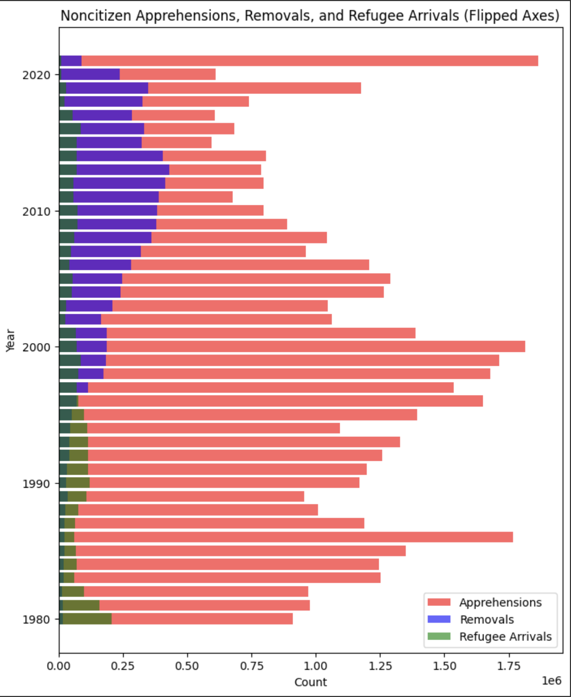
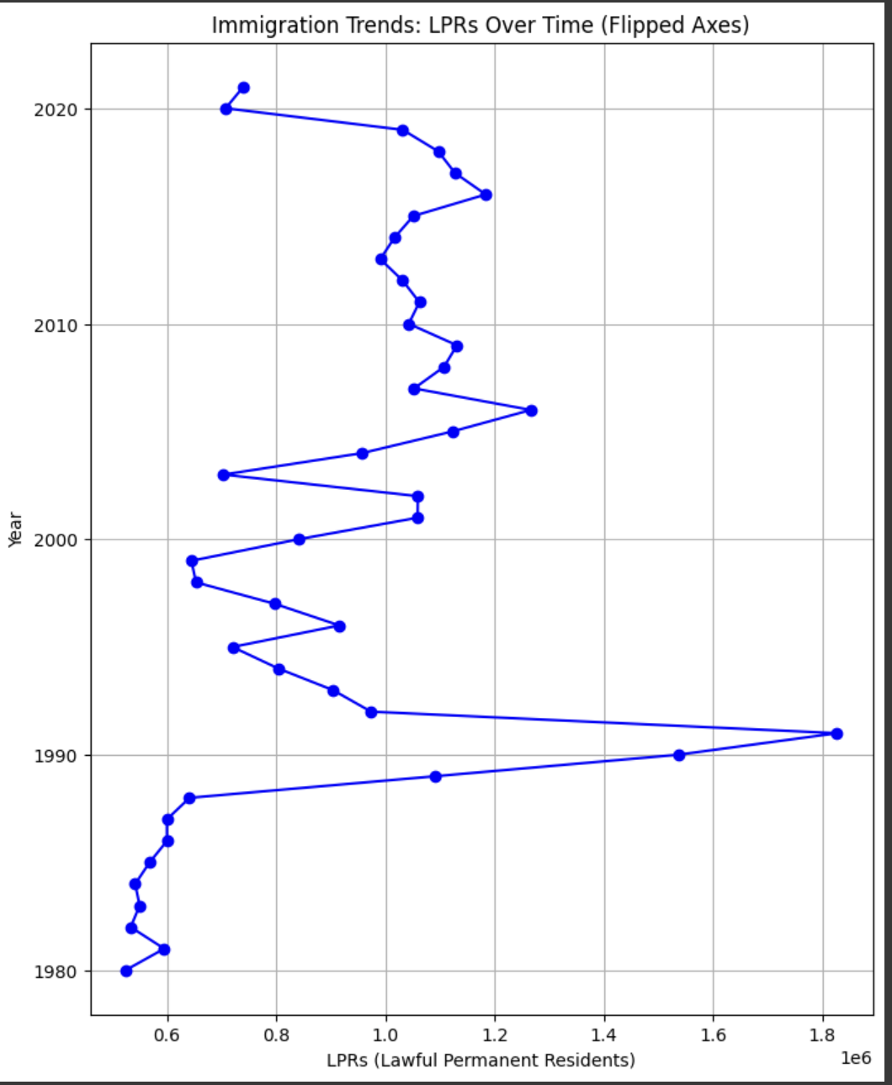
Visualizing the Trends:

Slide 10
Discussion
What Did We Learn?
Content:
Main Insights:
Immigration policies significantly impact trends.
Strict enforcement laws (e.g., 1996) led to more removals.
Economic and global crises influence refugee arrivals.
Implications:
Policymakers should consider long-term impacts of immigration laws.
Public perception of immigration often differs from data trends.

Slide 11
Limitations
Limitations of the Study
Content:
Data Limitations:
Aggregated data, lacks individual-level details.
No direct causation—only correlation.
Methodological Limitations:
More advanced statistical modeling could improve predictions.
External factors (e.g., economic crises) not fully accounted for.

Slide 12
Conclusion & Q&A
Final Thoughts
Content:
Immigration trends are shaped by policy changes and global events.
Data analysis helps us understand these shifts objectively.
Questions?

